Slide 1

Bankruptcy Prediction
Team 12
Angela Zheng, Beca Wang, Nimo Man

Slide 2

Table of Contents
01 Introduction
02 Data Overview
03 Feature Engineering
04 Modeling
05 Model Evaluation & Selection
06 Conclusion & Future Work
Notes:
Here is our genda for today.

Slide 3





Our Team
Angela Zheng
Nimo Man
Beca Wang
Data Scientist
ML Engineer
Data Analyst

Slide 4
01
Introduction

Slide 5


Problem Statement
Bankruptcy predictions: assess the financial condition of a company
Affect stakeholders in making significant decisions concerning the relationship with companies.

Slide 6
02
Data Overview

Slide 7
Basic Info
Dataset Introduction
Data Type & Quality
First Impression
Data was collected from the Taiwan Economic Journal for the years 1999 to 2009.
Company bankruptcy was defined based on the business regulations of the Taiwan Stock Exchange.
Total 10.93 MB
95 input features + 1 output feature
6819 rows (=companies)
Mostly, numeric input variables
No missing data, no null values, no duplicated rows
Pretty clean dataset
Correlations among different features
Unnormalized dataset
Imbalanced dataset

Slide 8
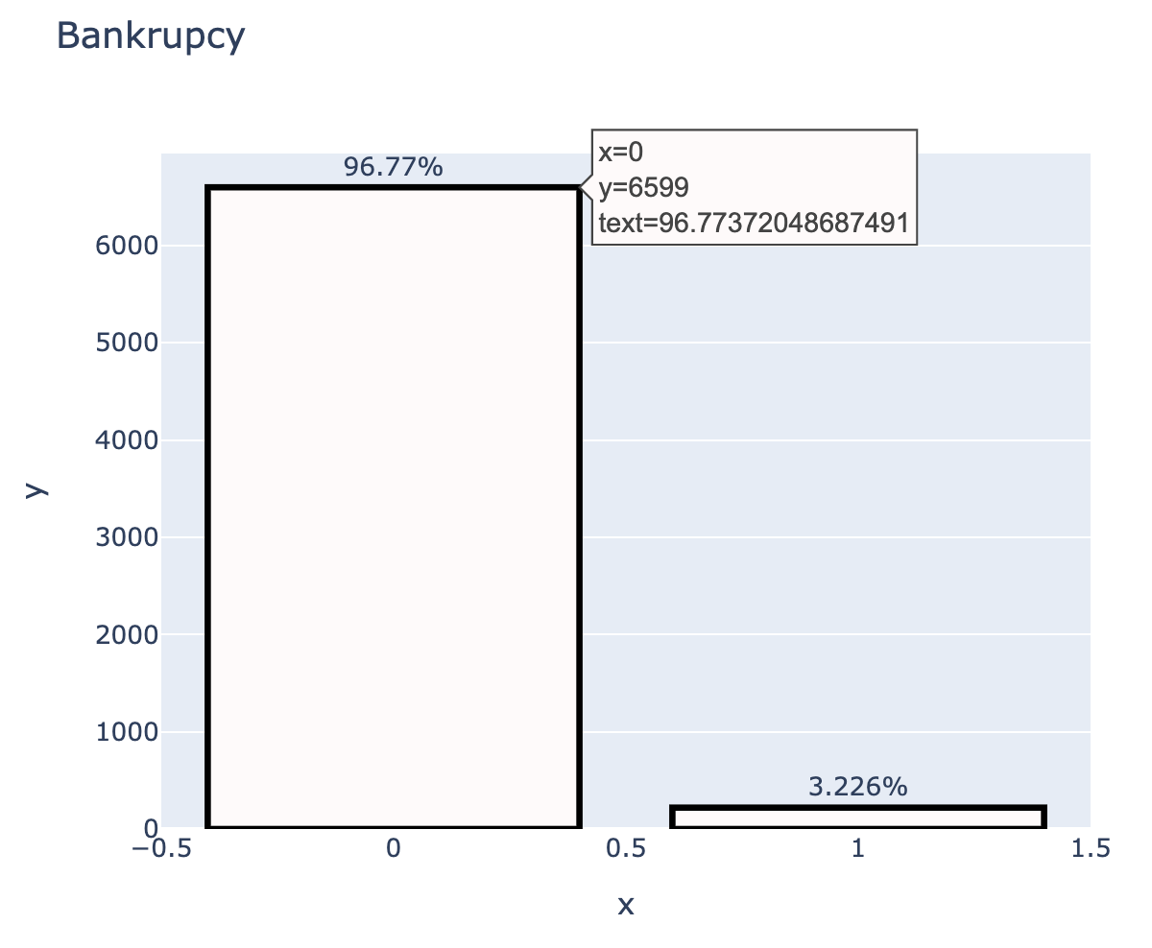
EDA
First, IMBALANCED dataset
Thus, using accuracy as the evaluation metric is not relevant
use F1 score instead.
use the SMOTE method to further balance the data.

Slide 9
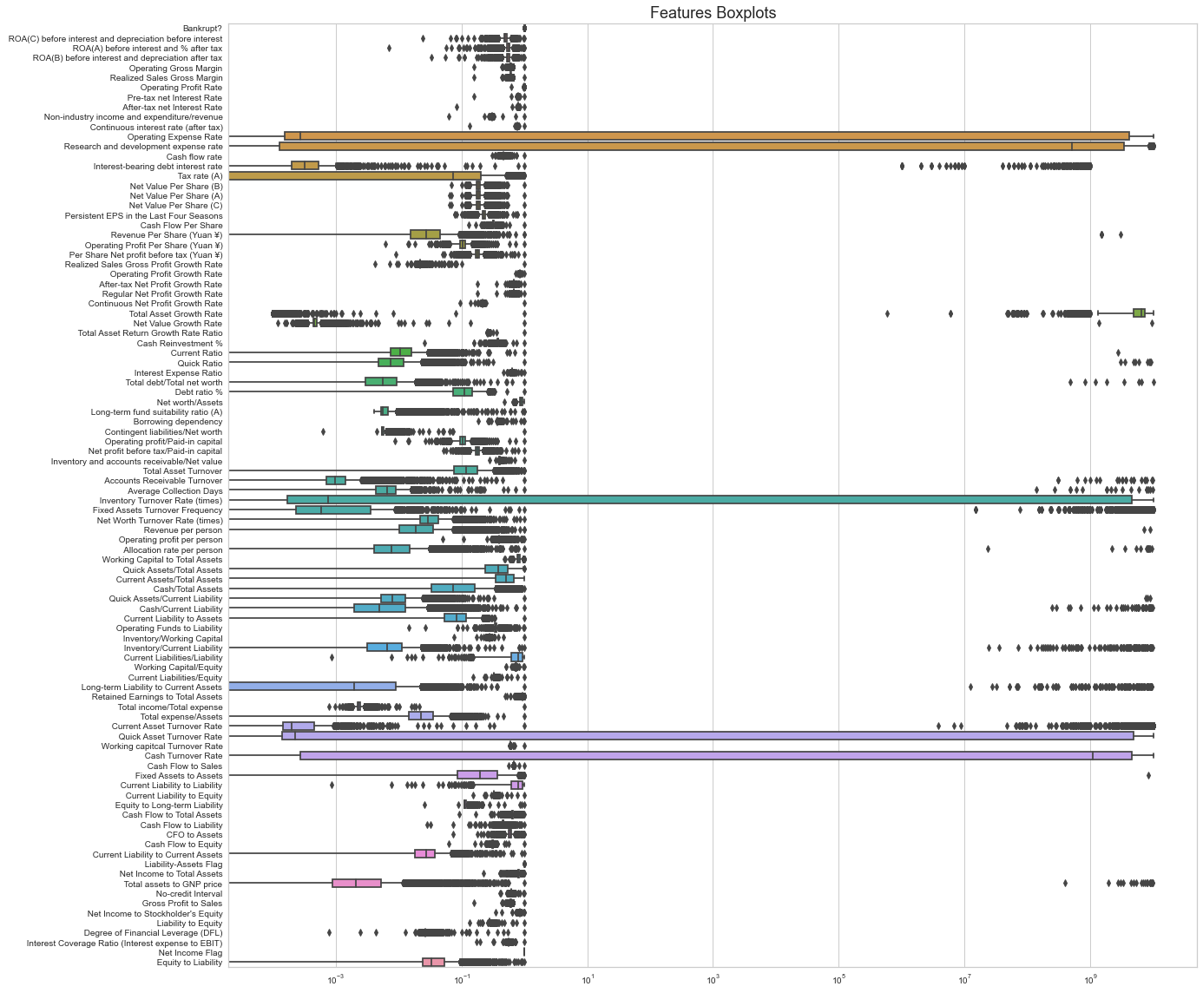
EDA
Second, UNMORMALIZED dataset
Thus, using the scaling method, StandardScaler() to transform the data.

Slide 10
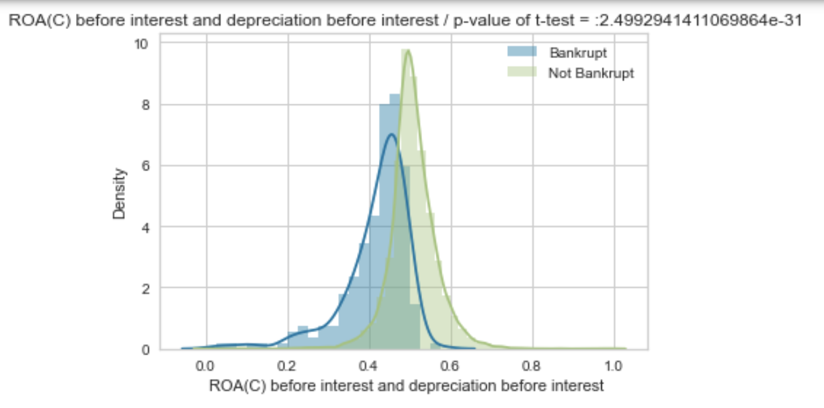
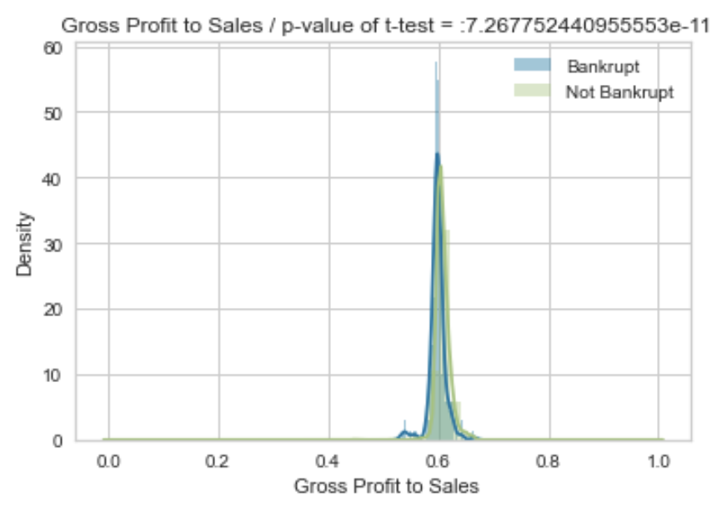
EDA: each variable’s distribution

Slide 11
03
Feature Engineering

Slide 12
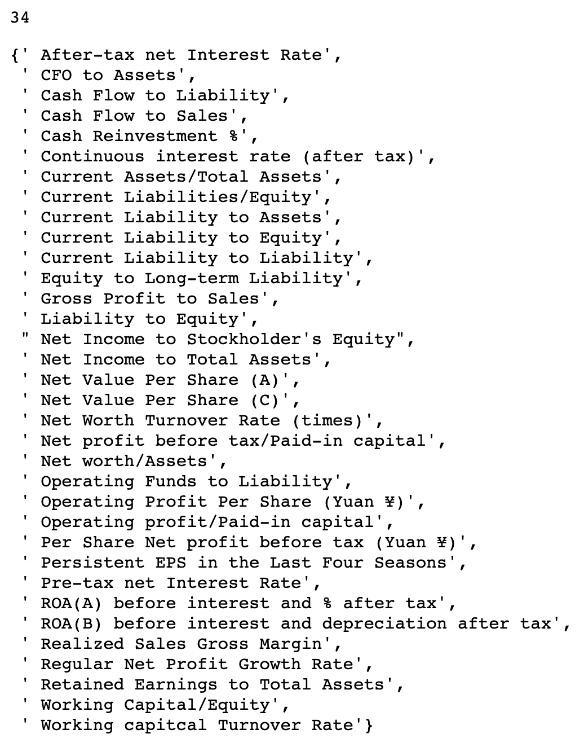
Deal with inner correlation
Delete the features which have a high correlation between themselves but keep the one which is most relevant to y
Total 34 features

Slide 13
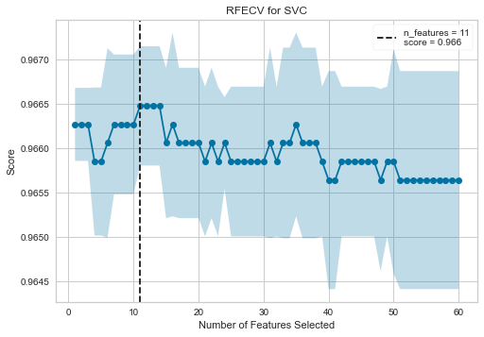
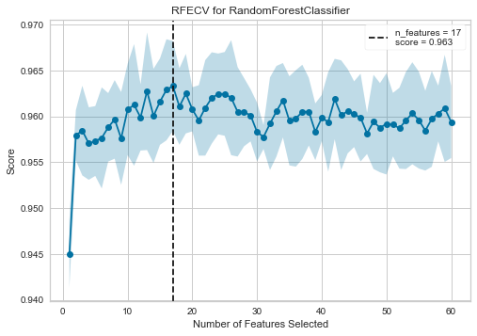
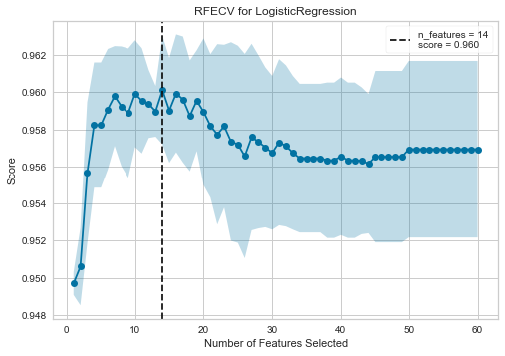
rfecv + different models
with linear SVM classifier
with Random Forest classifier
with Logistic Regression

Slide 14
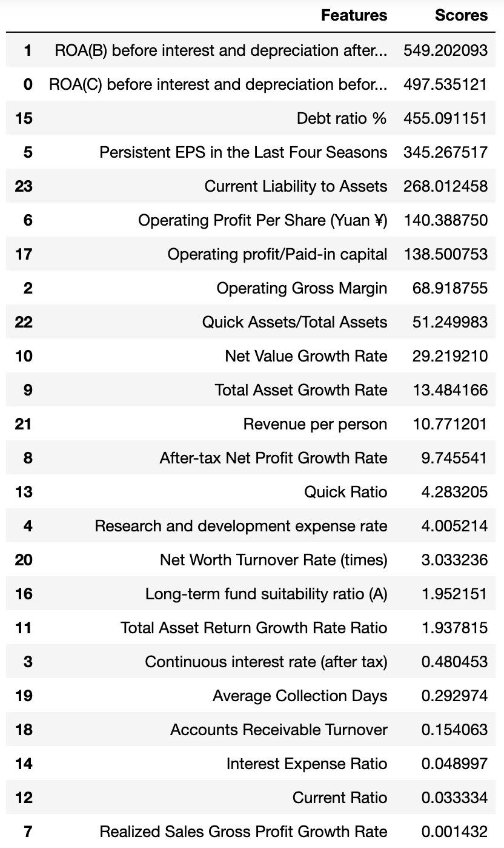
Get the score on correlation with y
****
Only keep 11 features in the end

Slide 15
Our Business Model
ROA(C) before interest and depreciation before interest: Return On Total Assets(C)
ROA(B) before interest and depreciation after tax: Return On Total Assets(B)
Operating Gross Margin: Gross Profit/Net Sales
Persistent EPS in the Last Four Seasons: EPS-Net Income
Operating Profit Per Share (Yuan ¥): Operating Income Per Share
Operating profit/Paid-in capital: Operating Income/Capital
Quick Assets/Total Assets
Net Value Growth Rate: Total Equity Growth
Debt ratio %: Liability/Total Assets
Current Liability to Assets
Notes:
As the features listed above, the top 7 features has negative relationship with y while the bottom 3 has the positive one. Some rationale for the left variables are, for instance, ROA & Total Asset Turnover provide information regarding how effective the investing strategy is. It also gives an indice on profitability. ((Also, net value and debt ratio provide interesting relations between total assets and total debt (= financial risk))

Slide 16
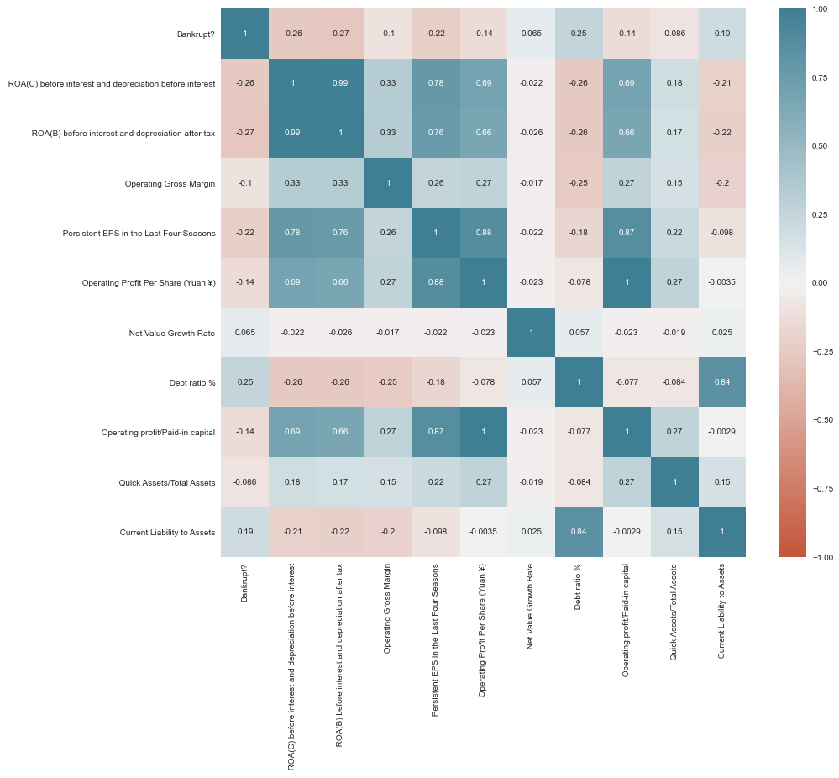
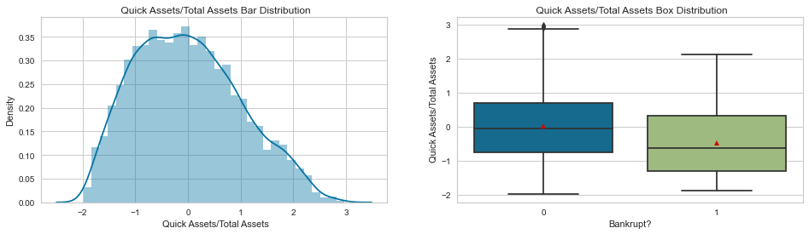
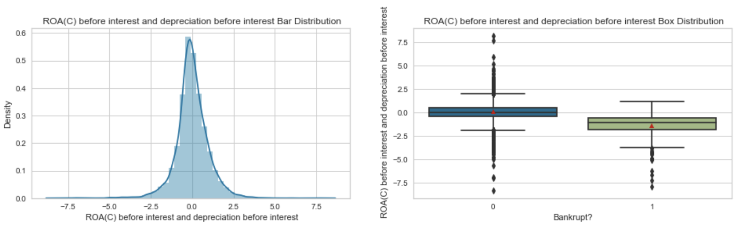
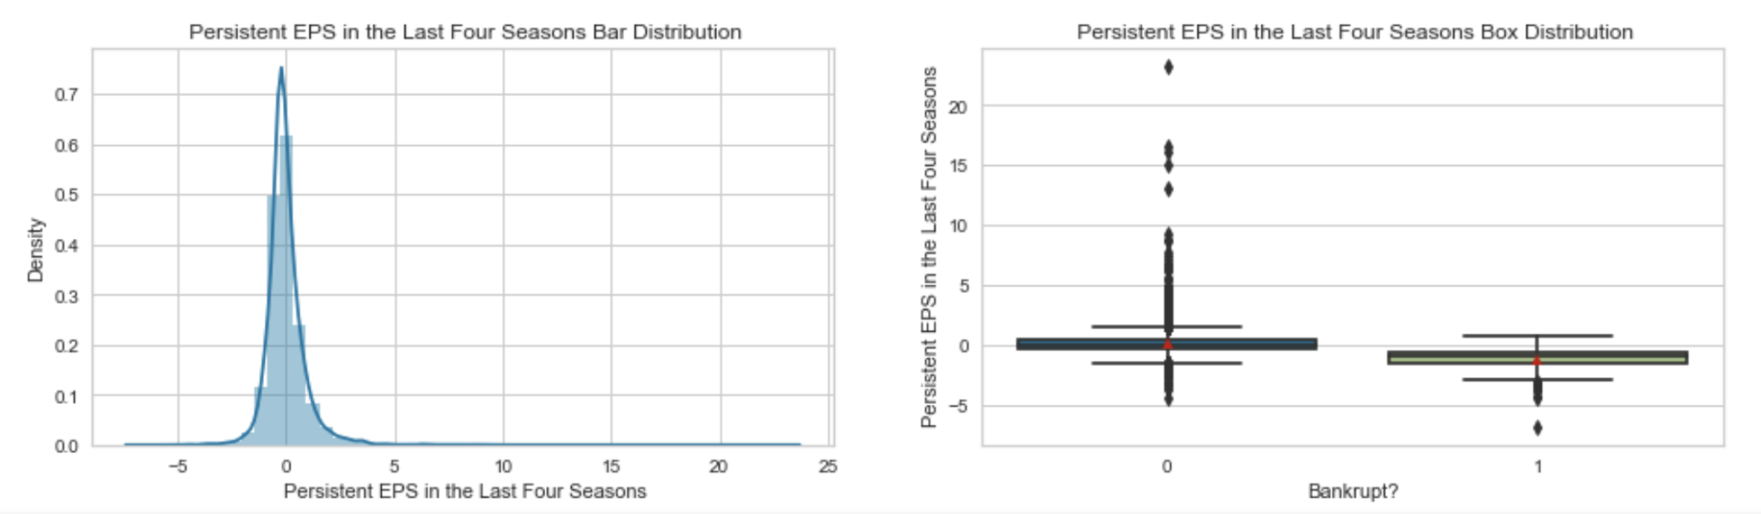
Final EDA

Slide 17
04
Modeling

Slide 18
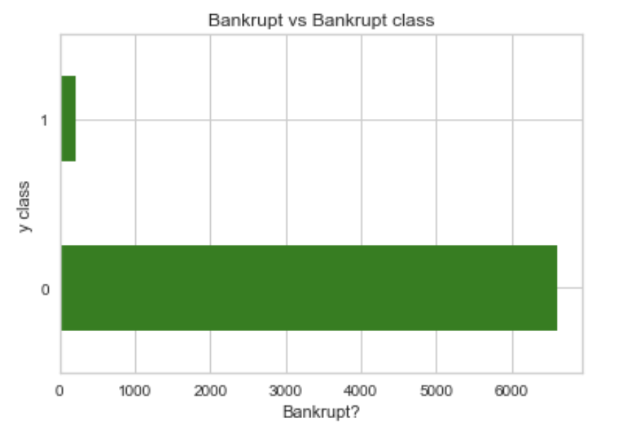
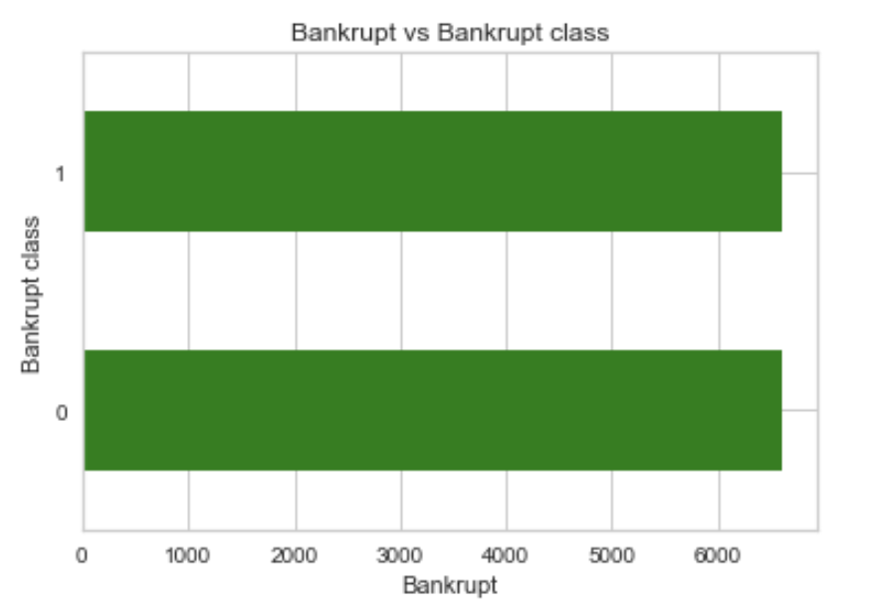
SMOTE for Imbalanced Data
Synthetic Minority Oversampling Technique works by utilizing a k-nearest neighbor algorithm to create synthetic data.
SMOTE first start by choosing random data from the minority class, then k-nearest neighbors from the data are set.
Synthetic data would then made between the random data and the randomly selected k-nearest neighbor.
The procedure is repeated enough times until the minority class has the same proportion as the majority class.

Slide 19
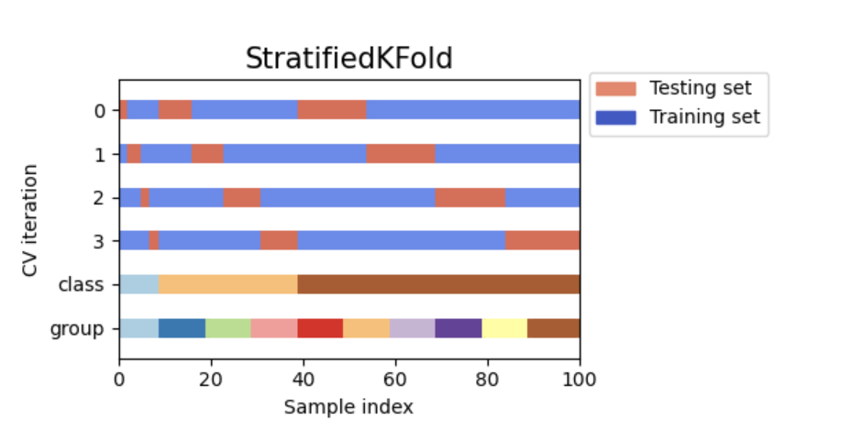
Repeated Stratified K-Fold Cross Validation
repeats Stratified K-Fold Cross validation n times with different randomisation in each repetition. Same as Stratified K-Fold, entire data set is divided into k subsets. For each iteration it approximately maintains same percentage of samples of each target class.

Slide 20
Classification Models
Logistic Regression
Random Forest
Artificial
Neural Network
Gradient Boost
Ada Boost
XGBoost
Train-Test Split
Feature Importance
Early Stopping
GridSearchCV + RepeatedStratifiedKFold
GridSearchCV + RepeatedStratifiedKFold
RandomizedSeachCV + RepeatedStratifiedKFold

Slide 21
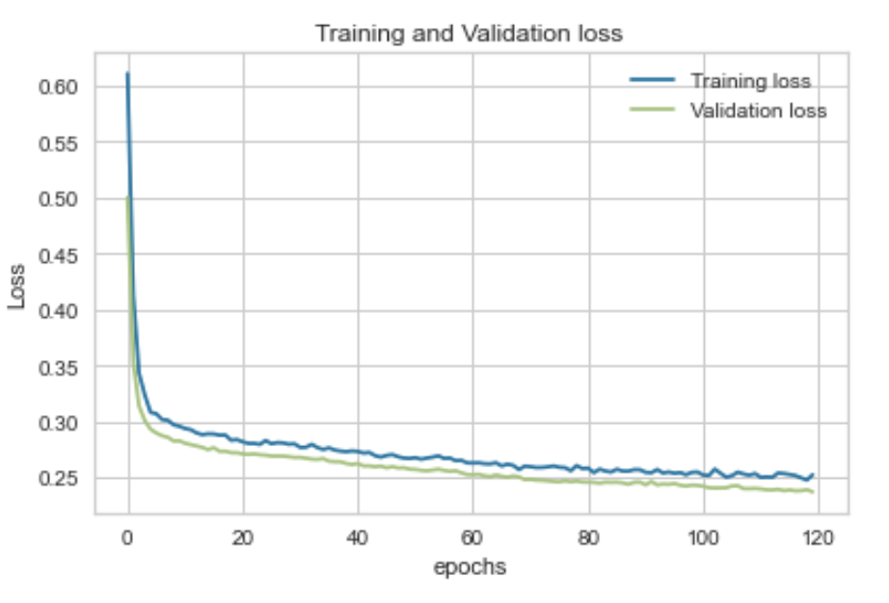
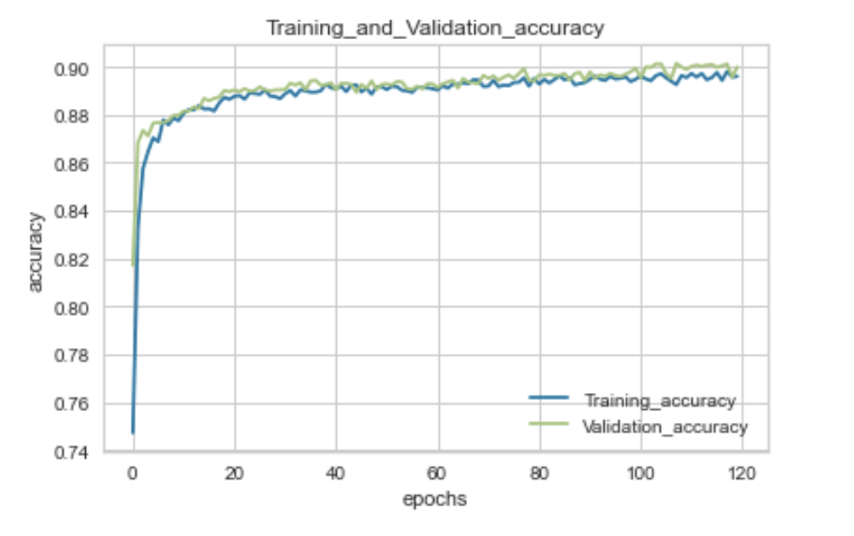
Artificial Neural Network
4 layers
Dense -> ‘relu’
Dropout -> 0.1
Dense -> ‘relu’
Dense -> ‘sigmoid’
Early Stopping
Monitor -> ‘val_auc’
Mode -> ‘max’
Compile
Loss -> ‘binary_crossentropy’
Optimizer -> ‘adam’
Metrics -> ‘accuracy’

Slide 22
Ada Boosting
Parameter Tuning
Feature Importance
Persistent EPS in the last four seasons
Debt ratio %
ROA(B) before interest and depreciation after tax
Operating Gross Margin
Operating Profit/Paid-in Capital
N_estimators: [100,200,300,400]
Learning_rate: [0.2,0.4,0.6,0.8,1,1.2]

Slide 23
XGBoosting
Parameter Tuning
Feature Importance
Persistent EPS in the last four seasons
Debt ratio %
ROA(B) before interest and depreciation after tax
Operating Gross Margin
Operating Profit/Paid-in Capital
N_estimators: 300
Learning_rate: 0.1
Max_depth: 1
Gamma: 2

Slide 24
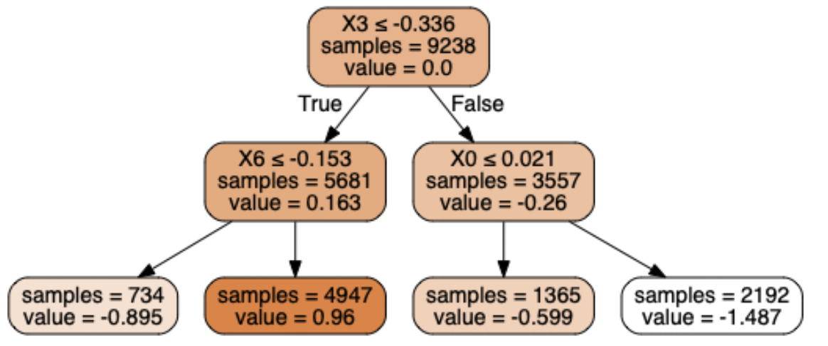
Gradient Boosting
Parameter Tuning
Feature Importance
Persistent EPS in the last four seasons
Debt ratio %
ROA(B) before interest and depreciation after tax
ROA(C) before interest and depreciation
Current liability to asset
N_estimators: [100,200,300,400]
Learning_rate: [0.2,0.4,0.6]
Max_depth: [1,2]

Slide 25
05
Model Evaluation & Selection
Notes:
Now moving to the model evaluation part

Slide 26
Model Evaluation
Model Name | Test F1 | Test ROC | Training F1 | Training ROC
Logistic Regression | 0.86 | 0.94 | 0.87 | 0.94
Random Forest | 0.94 | 0.99 | 1.00 | 1.00
ANN | 0.88 | 0.95 | 0.90 | 0.96
Gradient Boosting | 0.92 | 0.98 | 0.98 | 0.99
Ada Boosting | 0.87 | 0.94 | 0.88 | 0.95
XGBoosting | 0.87 | 0.94 | 0.89 | 0.95

Slide 27
06
Conclusion & Future work

Slide 28

Takeaways: Top 5 Features
Persistent EPS in the last four seasons
Debt ratio %
ROA(B) before interest and depreciation after tax
ROA(C) before interest and depreciation
Current liability to asset

Slide 29
Conclusion
Gradient Boosting performed the best and gave the highest accuracy
However, all other models performed very well with very close accuracy scores compared with Gradient Boost
All models (except for Random Forest) have slightly higher training accuracy scores than test accuracy scores, which might indicate overfitting issue but not severe
Future Work
Try more values for the hyperparameter tuning using GridSearch
Add more parameters
Use more recent data to retrain the model (data was collected for the year from 1999 to 2009)

Slide 30
Thank You

